Slide 1

Classrooms without Scripts: Using Improv in the Second Language Classroom
Aviva Levin
www.lessonimpossible.com
aviva.levin@gmail.com
WAFLT-COFLT FALL CONFERENCE

Slide 2


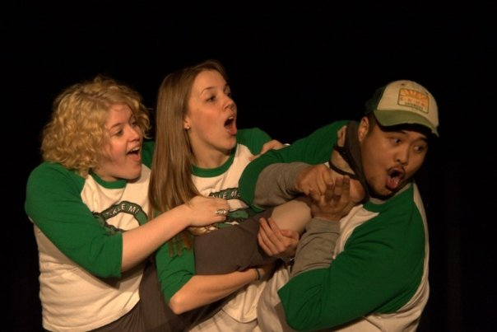

Slide 3
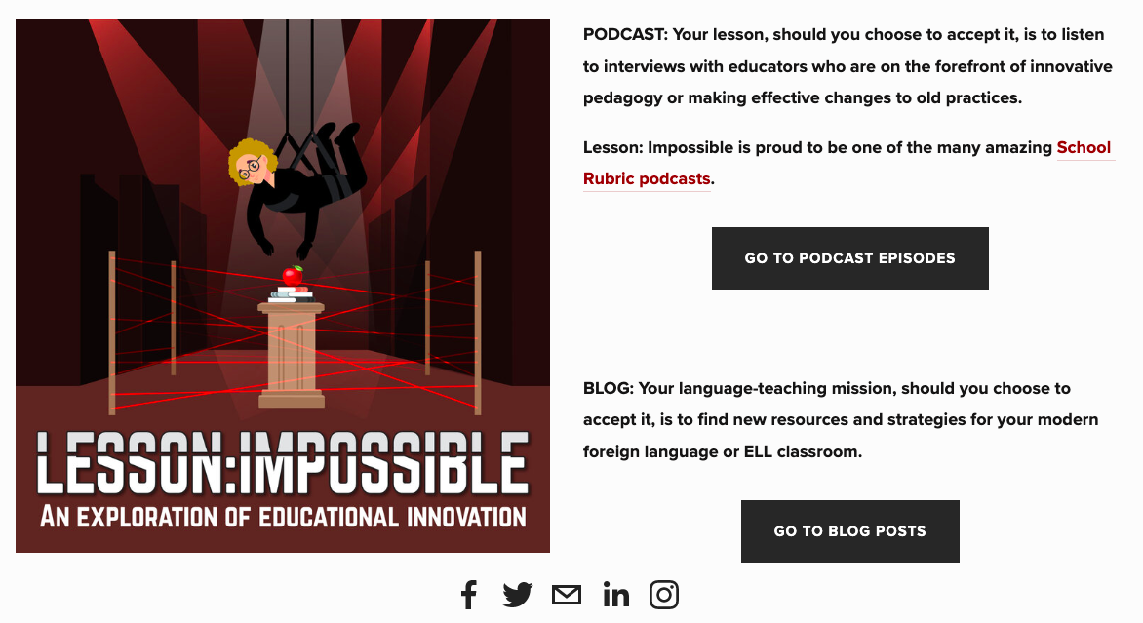
www.lessonimpossible.com

Slide 4
Big Ideas
Improv (creating spontaneous-ish scenes) is an engaging and different way for students to show the teacher what they know
Improv allows all students, regardless of ability, to participate and be successful
Improv is easy to implement into the classroom, as long as an emotionally safe environment is established
Improv allows students to tell stories that incorporate people that look, sound and act like them, because they are the ones creating and performing it

Slide 5
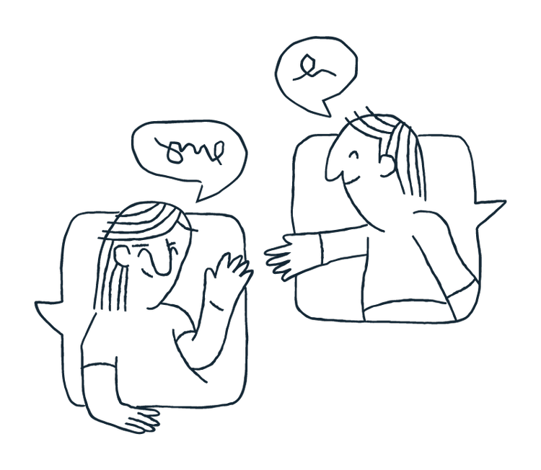
What is improv?
See: www.lessonimpossible.com/blog/what-is-improv

Slide 6


Community – Drama/improv creates a sense of community in the language classroom (Angeliannawati, 2019; Badie, 2014; Keränen, 2019; Lobman & Linquist, 2007; Perone, 2011; Piccoli, 2018; Smith & McKnight, 2009)
Communication – Students are able to communicate better when using drama/improv to learn a language (Florea, 2011; Galante & Thomson, 2017; Keränen, 2019; Perone, 2011)
Creativity – Drama/improv lets both students and teachers be more creative (Belliveau & Kim, 2013; Cristea, 2019; Lenters & Smith, 2018; Piccoli, 2018; Rojabi & Mustofa, 2021)
Confidence – Students become more confident in their use of the target language when engaged in drama/improv activities (Atas, 2015; Even, 2004; Galante, 2018; Gillette & Perry, 2021; Kurtz, 2011; Perone, 2011; Piazzoli, 2011; Piccoli, 2018; Smith & McKnight, 2009)
Cultural sensitivity – Drama/improv allows students to better understand different cultures, as well as their own (Angeliannawati, 2019; Belliveau & Kim, 2013 ; Bournot-Trites, et al., 2007; Gillette & Perry, 2021; McGovern, 2017; Ntelioglou, 2011)
Carrot (not stick) – Students are more motivated to learn a language when engaging in drama/improv (Bournot-Trites, et al., 2007; Cahmann-Taylor & McGovern, 2021; Lenters & Smith, 2018; Piazzoli, 2011; Smith & McKnight, 2009)
Content knowledge – Drama/improv improves student’s understanding of the target language (including grammar) (Angeliannawati, 2019; Even, 2004 & 2011; Kurtz, 2011; Lobman & Lundquist, 2007; Mochizuki & Ortega, 2008; O’Gara, 2008)
See: www.lessonimpossible.com/blog/the-7-cs-of-drama

Slide 7

So what does this look like in the classroom?

Slide 8
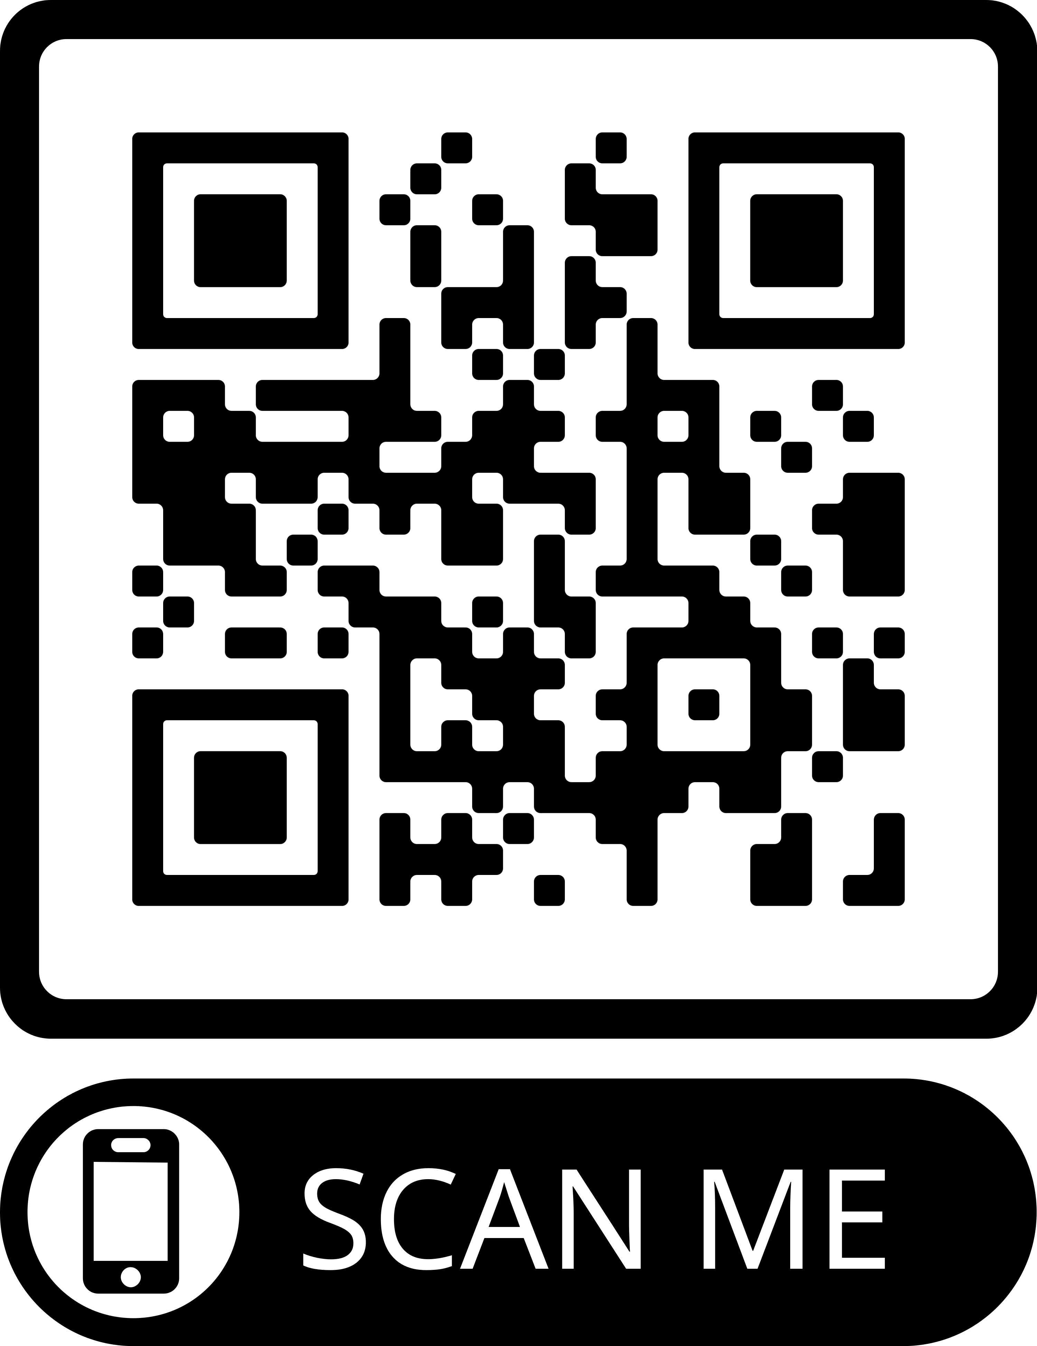
Notes:
Constantly navigating through these
Split over classes

Slide 9




Improv Games

Slide 10
Introductions!
Person A:
Introduce yourself: “Hi! I’m [name & title]”
Give a “gift” to Person B: “Here is a/an ---”
Person B:
Take the “gift”, say “thank you for the [adjective] ----”
Introduce yourself: “Hi! I’m [name & title]”
Transform the gift, make a new one, give it to Person C: “Here is a/an ---”
Use of the definite & indefinite article
Reinforcing vocabulary

Slide 12

Free Scenes
Students are given a ‘prompt’
Students are given time to create a scene (I usually allow class materials as reference)
  Translanguaging and cooperative skills
  Time to ask questions, puzzle things out
  Students feel more confident
Students present the scenes to the class
See: www.lessonimpossible.com/blog/prompts-for-free-scenes

Slide 13

Vocabulary/Grammar Prompts
Cat got your tongue
Hit the books
Take it easy
Prince
Frog
Fairy godmother
To play
To see
To eat
5 subjunctive sentence starters
Notes:
http://www.funwithforeignlanguage.com/wp-content/uploads/2014/02/14754056.jpg

Slide 14


Character/Settings Prompts
Notes:
Change up with différent characters and settings
If you have a IPA – research for the first part of the characters, show what students know through interpersonal
Can be real world people, like activitist
https://www.reddit.com/r/FavoriteCharacter/comments/mqnm0h/my_top_30_favorite_fictional_characters/
https://www.goodreads.com/topic/show/19239427-a-z-fictional-locations

Slide 15
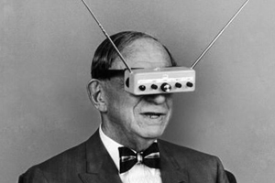
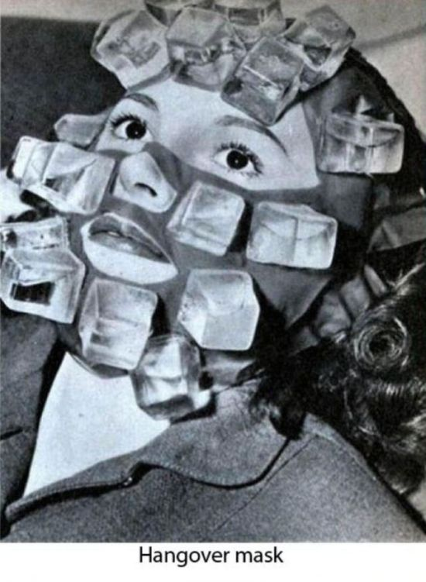
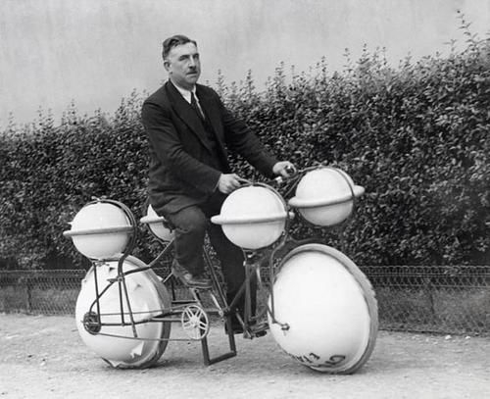
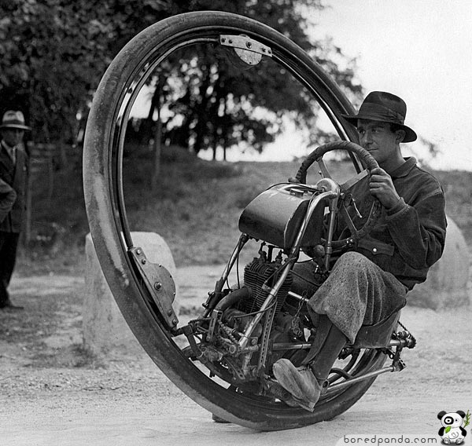
Picture Prompts
Notes:
What is this? What happened before this?
https://www.businessinsider.com/50-awesome-inventions-2010-9#neck-brush-9

Slide 16
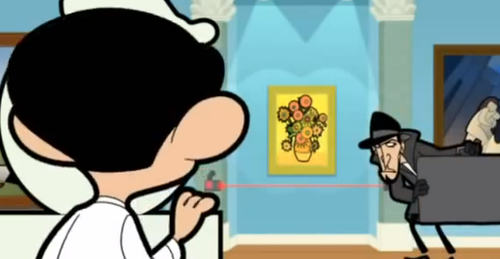
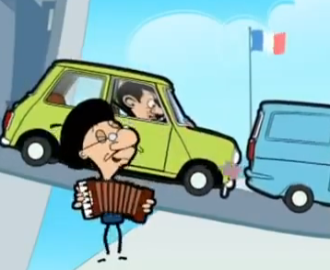
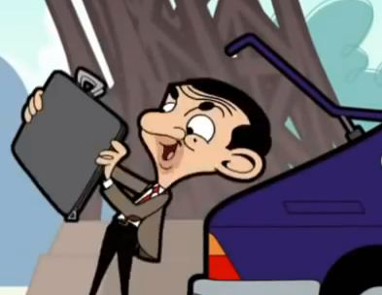
Preview Prompts
See: www.lessonimpossible.com/blog/picture-stories

Slide 17
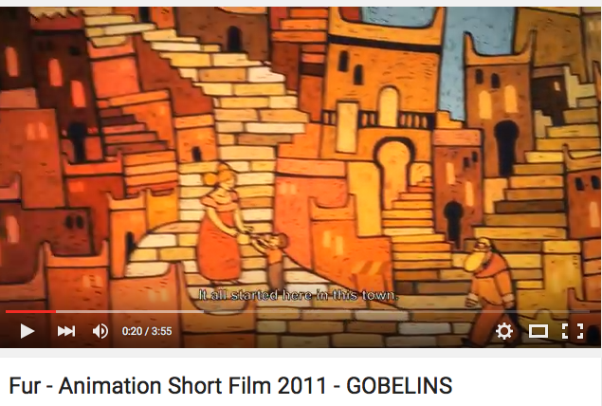
Movie Prompts
Notes:
Watch the first 10 seconds, do an impro to finish it
Give me an alternate ending; interview the characters on a talk show
https://www.youtube.com/watch?v=mUvk38Lu3l8#t=223.968072

Slide 18
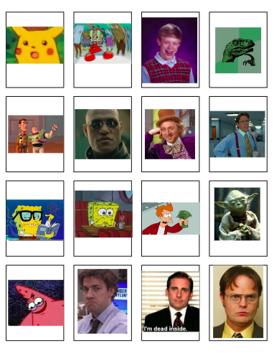
Anything…

Slide 19
Let’s give it a try!
3 vocab words per group
Each person must use at least 2 adjectives
Notes:
Everyone must use at least one adjective

Slide 21

Trouble-shooting & questions
How do you make time for this?
What about all the grammar?
Doesn’t this only work with higher levels?
What if my students don’t buy-in?
What if my colleagues think I’m crazy?
????????????
See: www.lessonimpossible.com/blog/addressing-arguments-against-drama
Notes:
http://www.clipartbest.com/cliparts/9ip/eaX/9ipeaXy6T.jpeg

Slide 22

Less teaching = improved ability?!?!
Ironically, for every minute I replace direct instruction of grammar with improv, my students’ grammar improves…
  grammar does not need to be taught and practiced exclusively in writing
  grammar is learned based on need, not as an abstract concept
  students are practicing and playing with grammatical concepts
  students see other students modelling more advanced grammar
Notes:
http://www.clipartbest.com/cliparts/9ip/eaX/9ipeaXy6T.jpeg

Slide 23
Starting slow
Start class with small warm-up games that reinforce grammatical concepts
See: www.lessonimpossible.com/blog/what-are-you-doing-improv-grammar-game
Add a game or scene to existing lesson plans in order to reinforce themes
Adapt scripted role-plays with added improv
See: www.lessonimpossible.com/blog/adapting-scripted-role-plays-with-improv

Slide 24

Why am I making you do this?
“we can quickly extract vocabulary”
“stay on our feet”
“be ready for conversational speaking”
“be able to listen to others speak French”
“practice speaking French like normal Frenchies”
“Improve our French in real-world scenarios”
“put our abilities to the test”
“best way to learn a new language”
“show what we instinctively know about the language”
“simulate real life conversations”
“helps us utilize different French words and phrases in a more casual setting”
“because you enjoy watching us fail… and then succeed”
Notes:
http://tipshomedesign.xyz/wp-content/uploads/2015/12/empty-classroom-clipart.jpg

Slide 25
What were your initial thoughts ?
“it would be hard to think of French words on the spot”
“but I’m not a good actor”
“this will help me improve my French”
“challenging and intimidating”
“scared and shy” “sad”
“exalted because it’s a lot of fun”
“scared because my French is not strong”
“this will help prepare me for the future when I’m using a language on the spot”
“I was terrified and wanted to hide under a rock”
“very excited” “nervous”
“I thought it would be impossible for us to improvise in French”
“it would be fun interacting and working with a group”
“S#!T…”

Slide 26
Have these thoughts changed or stayed the same?
“I still think that this was an important activity”
“I feel more confident as my French improves”
“I enjoy taking part and watching it”
“I realized that the audience just expects the plot to be funny and the lines to be simply understandable, so it’s not too difficult”
“I’m not frightened anymore because practice makes it seem ordinary”
“It’s fun!”
“Not only is it fun, it is a bit challenging, which is good”
“I don’t feel as judged or as scared”
“I realized that every skill needs to be practiced first before perfecting, so I am open to it”
“I like them now”
“I’m still sometimes nervous about presenting”

Slide 27
Has your French improved as a result of doing the impros?
“I am more comfortable with thinking about French words in sentences outside of my comfort zone”
“now I am able to speak French quickly”
“helped me concentrate on communicating ideas rather than perfect grammar”
“I am able to think on my feet more effectively in French”
“increased my fluency of many French phrases”
“allowed me to absorb concepts I couldn’t through paper”
“it makes French easier to understand by listening to others speak it”
“I have more confidence”
“I’ve started thinking in French instead of English first and then translating it”

Slide 29
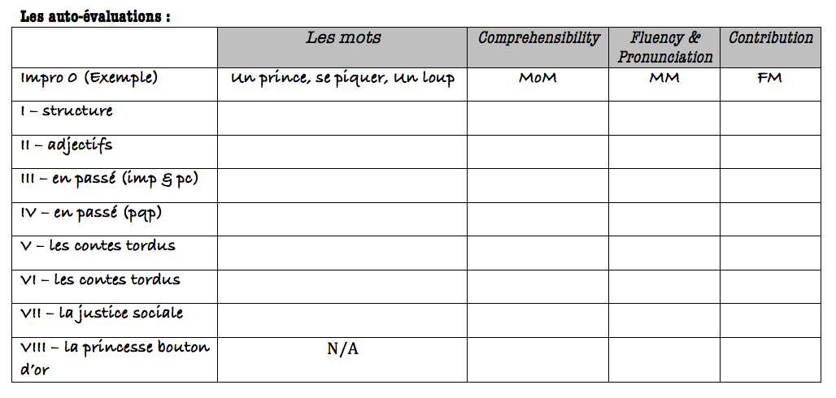
L’impro VII – la justice sociale
(Auto-évaluation)

